Slide 1
Bargaining and negotiations

Slide 2
Collective Agreements
Trade unions have great influence
The trade union confederations enter into national collective agreements with the employers
An agreement between an employer’s confederation or association and a trade union confederation concerning pay and working conditions
Pay and working conditions are usually better in workplaces that have collective agreements
Notes:
In Norway, trade unions have much greater influence than in many other countries.
A collective agreement is an agreement between an employer’s federation and a trade union federation concerning pay and working conditions.
In the public sector, the collective agreement applies to everyone
The size of your salary and other benefits depends on the terms agreed in the collective agreements

Slide 3
Principal settlement
In a principal settlement, the collective agreements are revised
Validity period for two years
All the provisions of the collective agreement are up for consideration
Wages, working hours, shift payments, entitlement to leave of absence, welfare allowances, etc
Obligation of peace between settlements
Notes:
The collective bargaining agreements also normally have a provision regarding mid-term of the contract period to be negotiated in order to adjust the salaries.

Slide 4
How are the settlements made in the union?
Ten months in advance, a debate booklet is sent out to all members by the local unions.
Through local member meetings, the collective agreement policy is discussed
Members may make alternative proposals
The summary forms a basis of parts of the debate at the regional collective agreement conference
The priorities and summaries are sent to the national board

Slide 5
National board in the union
The requirements are finally formulated and adopted by the national board
The Fagforbundet is the biggest union of the Norwegian Confederation, LO
In the municipal sector, the requirements are coordinated with the other unions in the confederation with members in the municipal sector (LO Kommune)
The requirements will then be handed over to our central employer counterparts

Slide 6
The shop stewards
All the shop stewards, from the local work place all the way to the President of the union, are elected by the members
According to the Basic Agreement, everyone elected as a full-time representative has the right to full-time leave as long as they are elected

Slide 7
Organised democracy
The final demands are a result of a long, democratic process in which many have expressed their opinions and helped to formulate requirements

Slide 8
Negotiations between the parties
Union representatives and employers' representatives meet to negotiate.
This can last for several weeks.
The annual wage-adjustments can be a combination of central and local negotiations. Central decision about the economic split between central and local economic framework. Central bargaining/control with what influences on macroeconomic aspects. The rest negotiated locally. “Income-policy cooperation” – see the whole picture.
Agreement between social partners on the statistical and economic basis and framework: The Technical Calculation Committee for Wage Settlements
Notes:
The Technical Calculation Committee for Wage Settlements - representatives of all trade union and employers’ confederations, representatives of Statistics Norway, Ministry of Labour and Social Affairs, Ministry of Finance, and Ministry of Local Government and Modernisation, which represents the Government as an employer

Slide 9
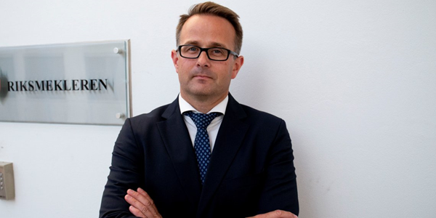
Mediation and disputes
The Labour Disputes Act (1915) is the legal basis for mediation:
Special court for legal disputes, Labour Court
Mandatory mediation before strikes/lock-outs
Obligation of industrial peace during period of validity of collective agreement
National Mediator appointed by government
Local wage bargaining break-downs are solved by arbitration
In the event of a conflict, there are strict rules for how both parties should act in the Basic Agreement
Mats Wilhelm Ruland, Riksmekler/National Mediator
Notes:
There is also an important legal framework for collective agreements and negotiations.
There is of course many aspects of the working environment that is regulated through legislation, and this regulation is in many cases overlapping the collective agreements.
But there is also a Labour Disputes Act, that regulates disputes between the employers and unions, and is the legal basis for mediation in conflict situations.
There is a National Mediator which is appointed by the Government.
The National Mediator must be notified for all strikes and lock-outs beforhand.
In local wage bargaining break-downs KS and the Confederations can solve the disputes by arbitration

Slide 10
Between the main settlements, we have intermediate settlements where we usually only negotiate financial supplements.

